Slide 1


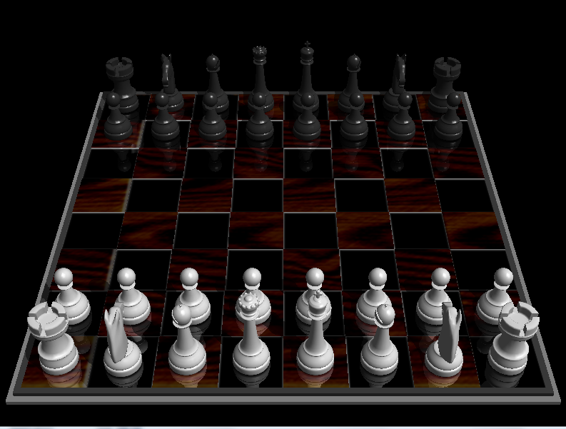
Animasi Catur 3D

Slide 2
Disusun Oleh:
Reki Setiawan - 10107107
Dudik Ikhwan Hidayah - 10107438
Anggi Maulana - 10107104

Slide 3
Pokok Bahasan
Using Textures
Function FlowChart
Loading a Bitmap Image
Generating & Binding Textures
Glut 3D Drawings
Transformation & Inverse Tranformation
Object Picking
Select & Render Modes
Simulated Graphics
DEMO

Slide 4





“Functions” FlowChart
Texture.cpp
Chess.cpp
Chars.cpp
LoadGLTextures
initialize
drawBoard
LoadGLTexture
draw
drawChars
ImageLoad
mouse
drawAskari
skb special keys
drawWazeer
Moves.cpp
kb keyboard
drawMalek
movePiece
Debug.cpp
drawTabya
inFront
fullDebugMode
drawHosan
kingProtected
flipBoard
drawFeel
whiteChar

Slide 5
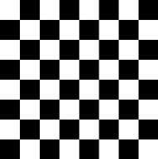
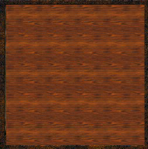
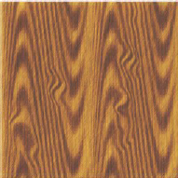
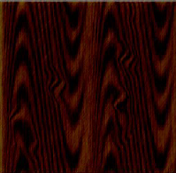
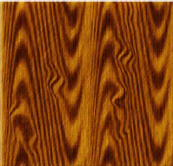
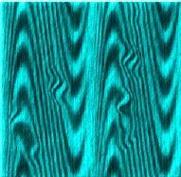
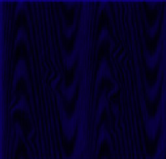
Using Textures
●
Loading A Bitmap Image
●
Generating & Binding Textures
●
Using Textures On Different Surfaces
CHESS_BOARD
BOTTOM_WOOD
WHITE_WOOD
BLACK_WOOD
SIDE_WOOD
WHITE_WOOD_C
BLACK_WOOD_C

Slide 6
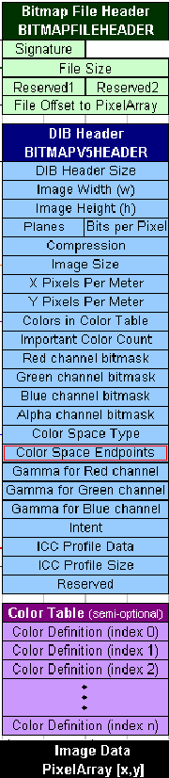
Loading A Bitmap Image
struct Image {
unsigned long sizeX;
unsigned long sizeY;
char *data;
};
int ImageLoad(const char *filename, Image *image)
{
FILE *file;
unsigned long size;
// size of the image in bytes.
unsigned long i;
// standard counter.
unsigned short int planes;
// number of planes in image (must be 1)
unsigned short int bpp;
// number of bits per pixel (must be 24)
// Make sure the file exists
file = fopen(filename, "rb")
// Skip to bmp header
fseek(file,18, SEEK_CUR);
// read width
i = fread(&image->sizeX, 4, 1, file)
//read the height
i = fread(&image->sizeY,4,1,file)
//printf("Height of %s: %lu\n", filename, image->sizeY);
// calculate the size (assuming 24 bpp)
size = image->sizeX * image->sizeY * 3;
// read the planes
fread(&planes, 2, 1, file)
// read the bpp
i = fread(&bpp, 2, 1, file)
// seek past the rest of the bitmap header
fseek(file, 24, SEEK_CUR);
// Read the data
image->data = (char *) malloc(size);
i = fread(image->data,size,1,file)
// reverse all of the colours bgr => rgb)
for (i=0;i<size;i+=3) swap(image->data[i] = image->data[i+2]);

Slide 7
Generating & Binding Textures
// create Texture
●
glGenTextures(1, &texture[textNum]);
//linear scaling
●
glBindTexture(GL_TEXTURE_2D, texture[textNum]);
// scale linearly when image is of a different size than texture
●
glTexParameteri(GL_TEXTURE_2D,GL_TEXTURE_MAG_FILTER,
GL_LINEAR);
●
glTexParameteri(GL_TEXTURE_2D,GL_TEXTURE_MIN_FILTER,G
L_LINEAR);
●
glTexImage2D(GL_TEXTURE_2D, 0, 3, image1->sizeX, image1-
>sizeY, 0, GL_RGB, GL_UNSIGNED_BYTE, image1->data);

Slide 8
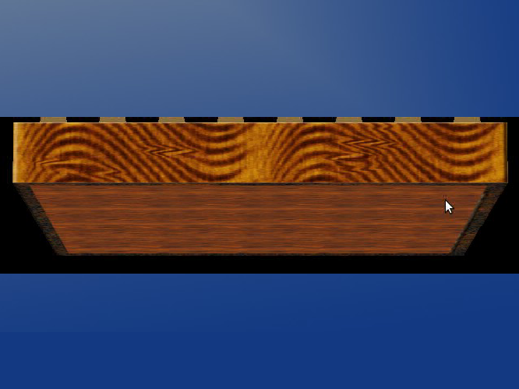
Using Textures On Different
Surfaces
●
The most important thing to notice is this
function:
–
glBindTexture(GL_TEXTURE_2D, texture[textNum]);
●
This function binds the texture referred to, to
any usage of it

Slide 9
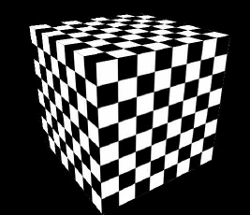
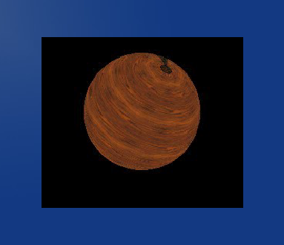
Examples on Using Textures
●
If used on a flat 2D polygon/quad:
–
glBindTexture(GL_TEXTURE_2D, texture[SIDE_WOOD]);
–
glBegin(GL_QUADS);
–
glTexCoord2f(0.0f, 0.0f); glVertex3f(-1.0f, -1.0f, 1.0f);
–
glTexCoord2f(1.0f, 0.0f); glVertex3f( 1.0f, -1.0f, 1.0f);
–
glTexCoord2f(1.0f, 1.0f); glVertex3f( 1.0f, 1.0, 1.0f);
–
glTexCoord2f(0.0f, 1.0f); glVertex3f(-1.0f, 1.0f, 1.0f);
–
glEnd();
●
If used on a Quadric Object:
–
glBindTexture(GL_TEXTURE_2D, texture[((blackWhite)?((chosen)?
WHITE_WOOD_C:WHITE_WOOD):((chosen)?
BLACK_WOOD_C:BLACK_WOOD))]);
–
GLUquadricObj *AskariSphere=gluNewQuadric();
//activate Texture
–
gluQuadricTexture(AskariSphere,true);
–
gluSphere(AskariSphere,DIV16-0.02,64,64);

Slide 10
Graphics: Chess Pieces & Board
●
Cuboid For Board
●
Types Of gluQuadric Objects Available
●
Types Of glut 3D Drawings
●
Transformation & Inverse Transformation
●
Linking Chess Pieces With BitBoard

Slide 11
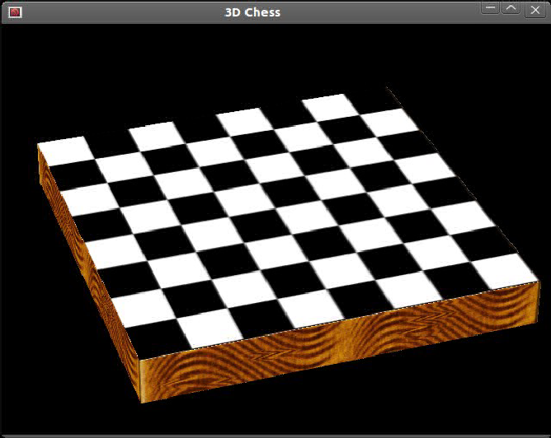
Cuboid For Board
●
The board is made of
6 quadrilaterals /
polygons for the
cuboid shape
●
Textures are bound to
each side with the
top side's
dimensions from -1
to +1 divided in 8
parts for proper
positioning of
pieces

Slide 12
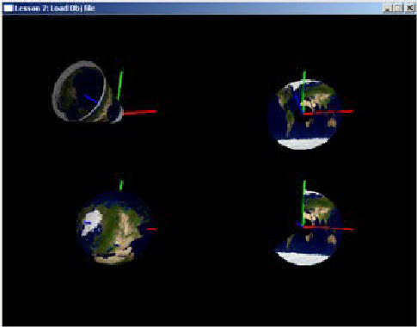
Types Of gluQuadric Objects
Available
●
gluCylinder //We Can Draw Cones With It Too
●
gluDisk
●
gluPartialDisk
●
gluSphere

Slide 13
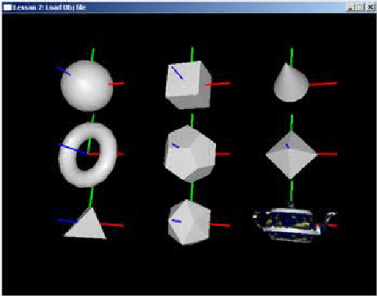
Types Of glut 3D Drawings
●
glutSolidSphere
●
glutSolidCube
●
glutSolidCone
●
glutSolidTorus
●
glutSolidDodecahedron
●
glutSolidOctahedron
●
glutSolidTetrahedron
●
glutSolidIcosahedron
●
glutSolidTeapot

Slide 14
Transformation & Inverse
Transformation
●
glRotatef, glScalef and glTranslatef all work on
world coordinates, meaning they will
transform all objects which is inconvenient
most of the time...
●
Transforming before drawing an object then
inverse transforming will allow us to
transform only the object!
–
e.g. glTranslatef(-1,-1,-1);//then draw object
–
glTranslatef(1,1,1);//this transforms everything
back leaving only the object transformed

Slide 15
Object Picking
●
Select and Render Modes
●
Pick Buffer
●
Ray Intersection With Simulated Graphics
●
Naming Objects

Slide 16
Select and Render Modes
●
There are three render modes
–
GL_RENDER
–
GL_SELECT
–
GL_FEEDBACK
●
We choose GL_RENDER mode for drawing
(default) and GL_SELECT mode for selecting
●
Changing the mode is done through
glRenderMode(/*mode*/)

Slide 17
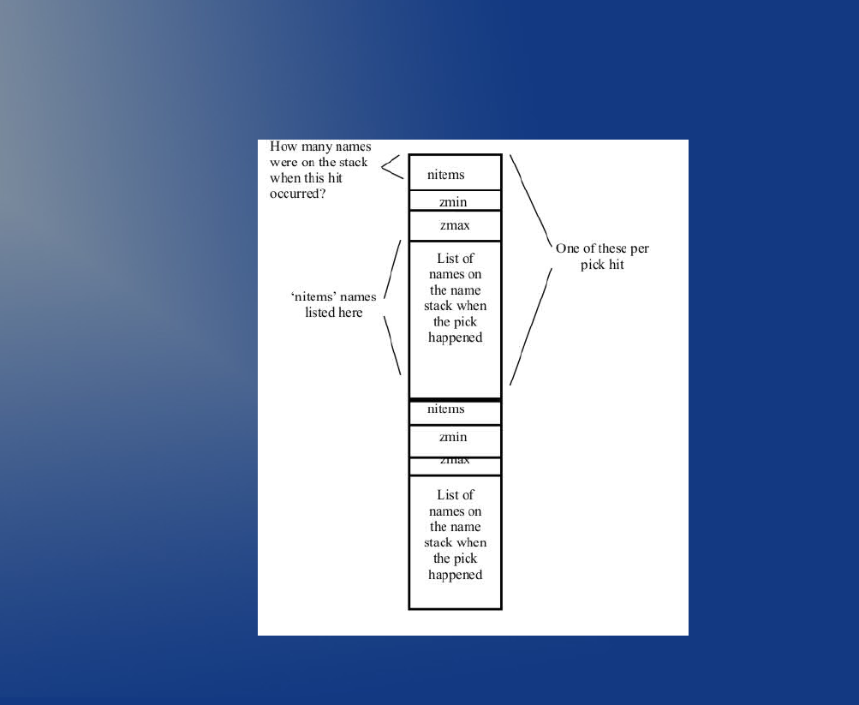
Pick Buffer & gluPickMatrix
●
A picking buffer is needed to
store the information
returned from picking,
PickBuffer
●
Linking to the buffer is done
through
glSelectBuffer(BUFFERSIZE
,PickBuffer)
●
gluPickMatrix(Xmouse,Ymous
e,toleranceX,toleranceY,vie
wport); Defines the region
that picking will be done in

Slide 18
Ray Intersection With Simulated
Graphics
●
A ray from the (x,y) of the mouse position is
simulated to intersect the objects
–
Minimum and maximum z-value of the last hit
object
–
z-value [0,1] is scaled by 232-1 (0xFFFFFFFF)
●
Then the contents of the PickBuffer are picked
from

Slide 19
DEMO

